Slide 1



[DM1]The “best” model for the autocorr of the full model is the Gaussian with a positive nugget not the AR1, but this is not the best model for all of the subsets that are needed to estimate each fraction here. For that reason I decided to go with an AR1 structure for all the models because this is a commonly assumed error structure that does a decent job most of the time.
Maybe a simpler solution is just to use a single parameter (non-parametric) moving average error model for all the models
Table #. Variation partitioning of richness into the its components for site (S), year (Y), and management (M) variables. The site and year variables were quantified using dummy variables and the management variable include years of bison, years since last burn, and the number of burns in the past five years. The table displays the unadjusted and adjusted OLS coefficients of determination (also displayed in Fig. #), as well as, as coefficients of determination for GLS models incorporating a single autoregressive terms.
 | OLS |  |  | GLS (AR1)
Factors (q)
S | Y U M (19) | 0.48 | 0.48 |  | 0.27
Y | S U M (10) | 0.13 | 0.13 |  | 0.18
M | S U Y (3) | 0.04 | 0.04 |  | 0.02
S ∩ Y | M | 0.01 | -0.02 |  | 0.25
S ∩ M | Y | 0.05 | 0.05 |  | 0.04
Y ∩ M | S | 0.08 | 0.07 |  | < 0.01
S ∩ Y ∩ M | -0.01 | -0.02 |  | < 0.01
Total (32) | 0.77 | 0.74 |  | 0.77
*Gen. R² = generalized coefficient of determination (Nagelkerke 1991) Note very little difference in Cox and Nagelkerke's def of R2 gls

Slide 2
Explanatory Variables | Covariables | Temporal Autocorrelation Model (range, nugget) | β |  | F-ratio | p-value
Factors (q)
site (19) | year + management | Gaussian (3.92, 0.55) | NA | 0.25 | 5.80 | < 0.001
year (10) | site + management | -- | NA | 0.21 | 12.87 | < 0.001
management (3) | site + year | -- | NA | 0.01 | 4.07 | 0.008
Site Specific Variables
log Ca | slope + northness + year + management | Exponential (10.91, 0.32) | -0.28 | 0.05 | 6.51 | 0.012
slope | log Ca+ northness + year + management | -- | -0.10 | < 0.01 | 0.71 | 0.400
northness | log Ca + slope + year + management | -- | 0.24 | 0.01 | 3.71 | 0.056
Year Specific Variables
summer rain | winter rain + spring rain + site + management | Exponential (0.85)* | -0.19 | 0.03 | 26.65 | < 0.001
winter rain | summer rain + spring rain + site + management | -- | 0.15 | 0.02 | 15.47 | < 0.001
spring rain | summer rain + winter rain + site + management | -- | 0.14 | 0.01 | 11.43 | 0.001
Management Variables
years of bison | years since last burn + # of burns in 5 years + site + year | Gaussian (3.92, 0.55) | 0.43 | 0.01 | 7.61 | 0.006
years since burn | years of bison + # of burns in 5 years + site + year | -- | -0.11 | < 0.01 | 3.52 | 0.062
# of burns in 5 years | years of bison + years since last burn + site + year | -- | -0.11 | < 0.01 | 1.34 | 0.249

Slide 3


[DM1]One thing that occurred to me it is the residuals of Y~covariable that are permuted and then used to create Ynew which is then fit to Ynew~X+covariable so the specification of my permutation methods as torodial or random may be misapplied. Maybe when site is an explanatory variable then it should be tororidal to keep the year structure in the covariables.
Explanatory Variable | Covariables | Type of Randomization * |  |  | F-ratio | p-value
Factors (q)
site (19) | year + management | random shuffle | 0.50 | 0.46 | 13.471 | 0.001
year (10) | site + management | toroidal shift | 0.04 | < 0.01 | 2.248 | 0.001
management variables (3) | site + year | random shuffle | 0.01 | < 0.01 | 2.145 | 0.001
-- | -- | toroidal shift | -- | -- | -- | 0.001
Site Specific Variables
log Ca | slope + northness + year + management | random shuffle | 0.13 | 0.12 | 19.735 | 0.001
slope | log Ca+ northness + year + management | random shuffle | 0.03 | 0.03 | 8.152 | 0.001
northness | log Ca + slope + year + management | random shuffle | 0.02 | 0.01 | 5.219 | 0.001
Management Variables
years of bison | years since last burn + # of burns in 5 years + site + year | random shuffle | < 0.01 | < 0.01 | 2.314 | 0.001
-- | -- | toroidal shift | -- | -- | -- | 0.001
years since burn | years of bison + # of burns in 5 years + site + year | random shuffle | < 0.01 | < 0.01 | 2.102 | 0.001
-- | -- | toroidal shift | -- | -- | -- | 0.001
# of burns in 5 years | years of bison + years since last burn + site + year | random shuffle | < 0.01 | < 0.01 | 1.616 | 0.001
-- | -- | toroidal shift | -- | -- | -- | 0.021

Slide 4
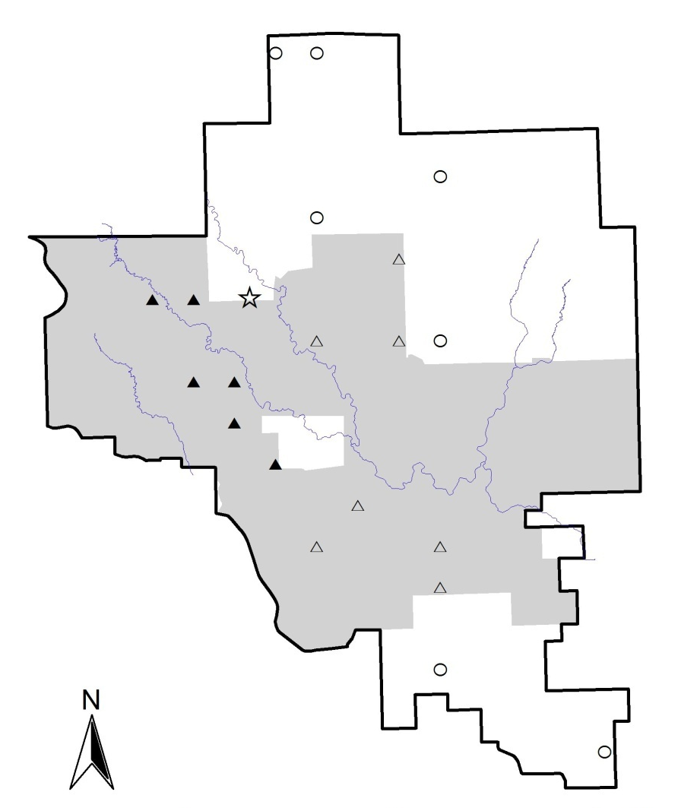
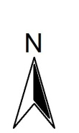
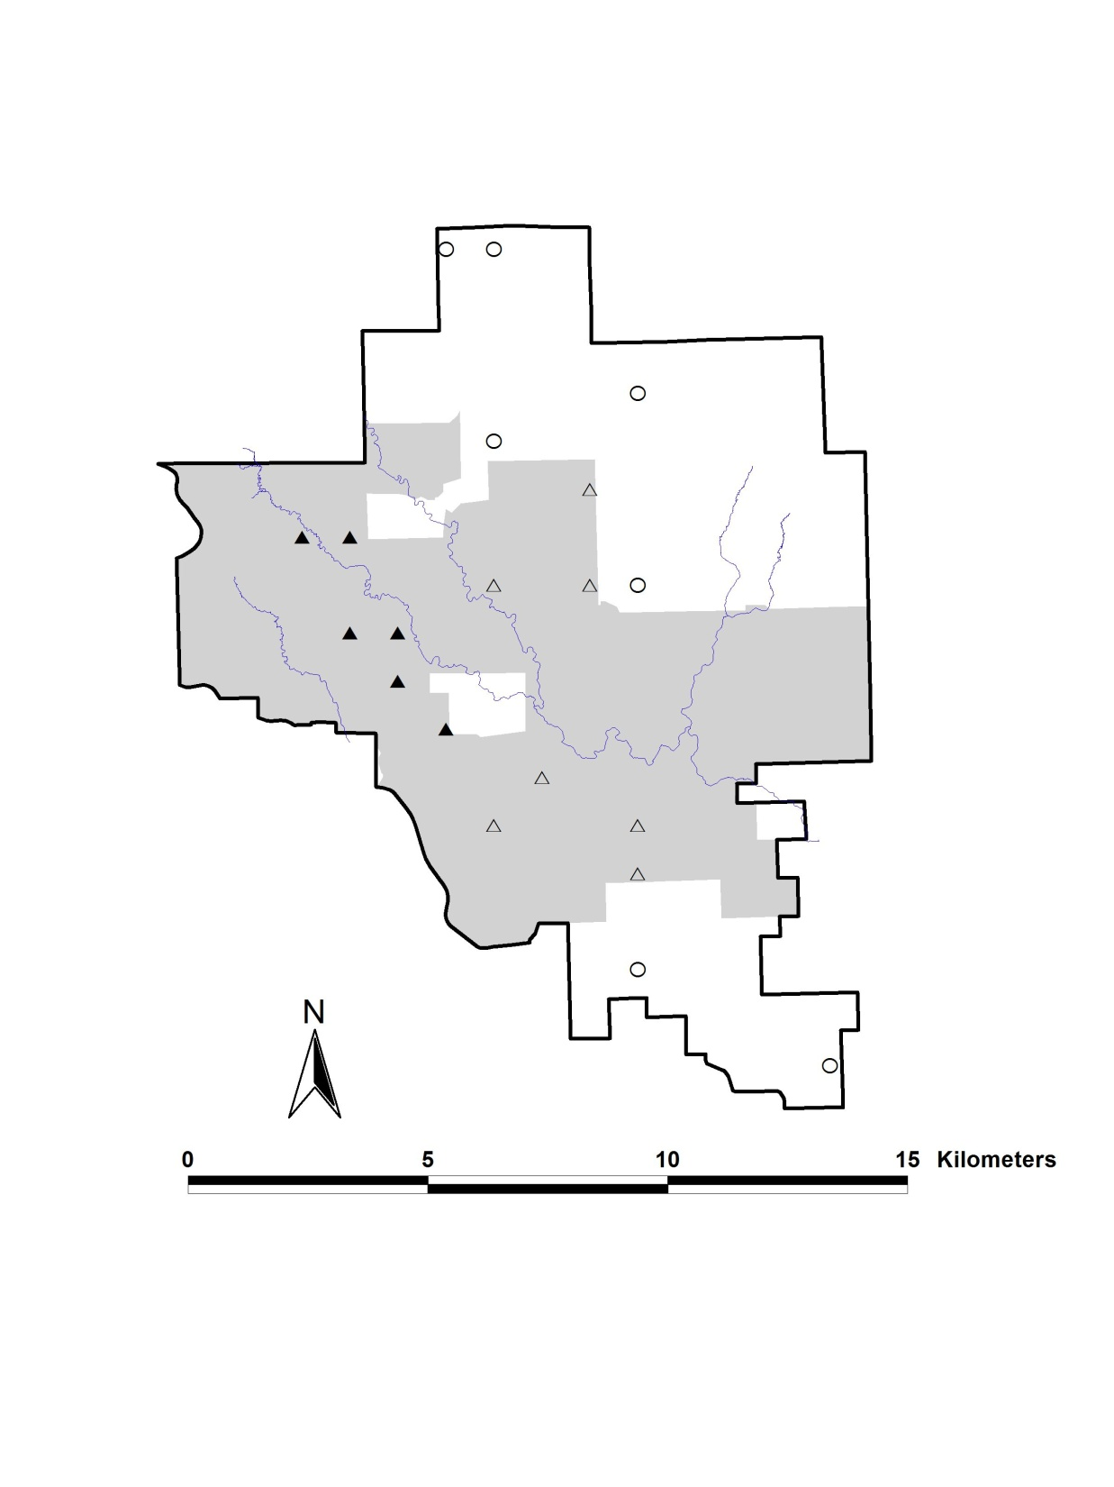
The Nature Conservancy’s
Tallgrass Prairie Preserve, Osage Co., OK, USA
Bison Unit
Mesonet tower
N
Bison
Transition
Cattle
0
5
10
15 km
Preserve Area ≈ 15,700 ha
Bison Unit Area ≈ 8,500 ha (54%)*

Slide 5
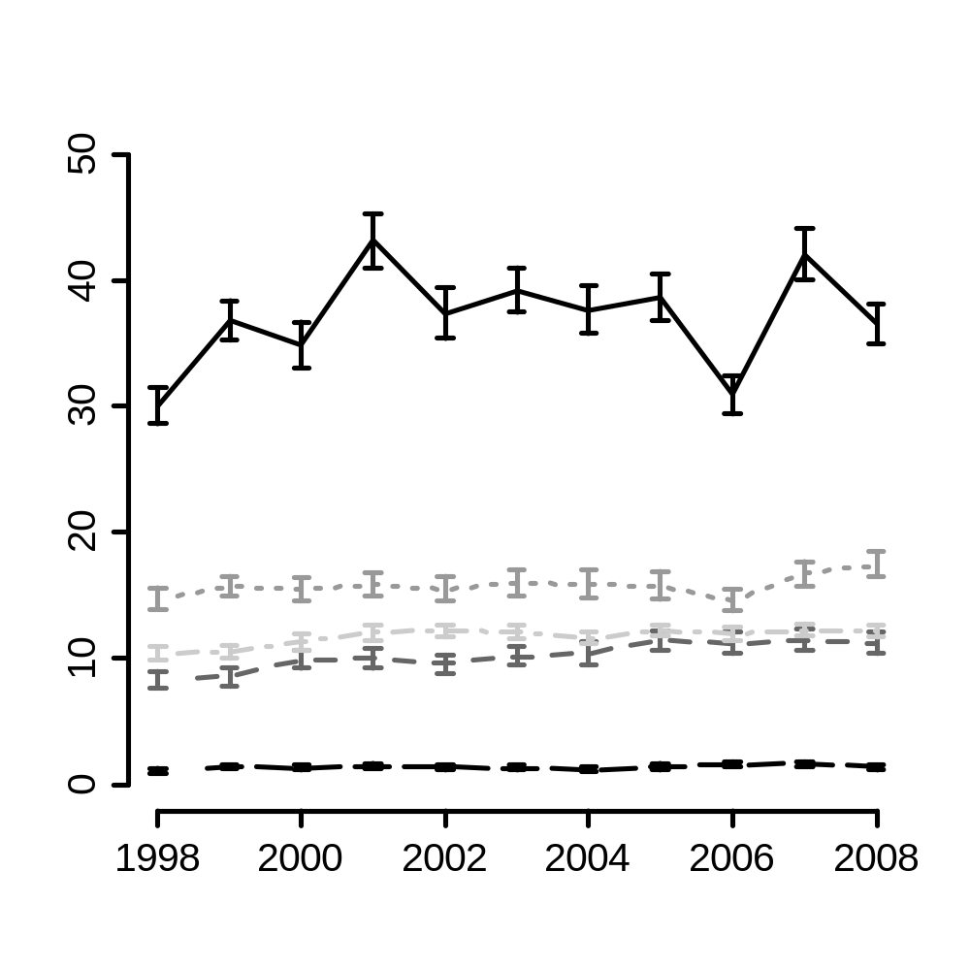
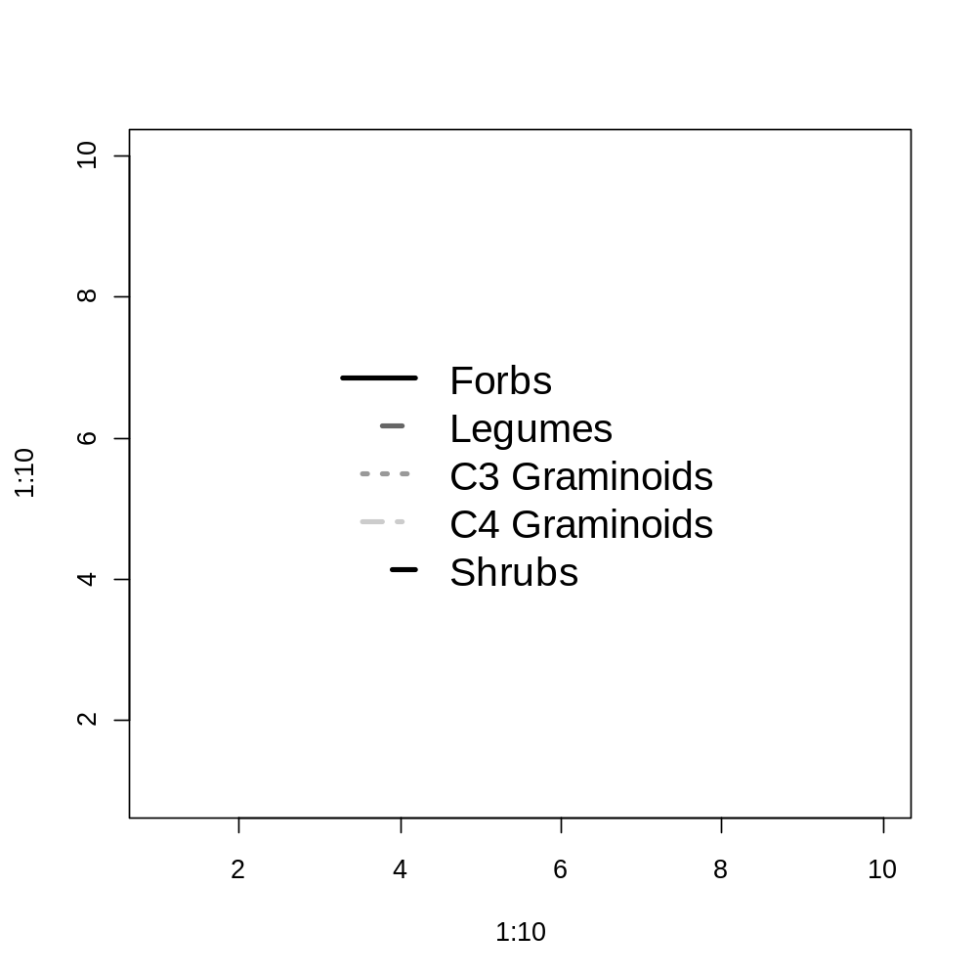
Average species richness (100 m²)
Year of sample

Slide 6
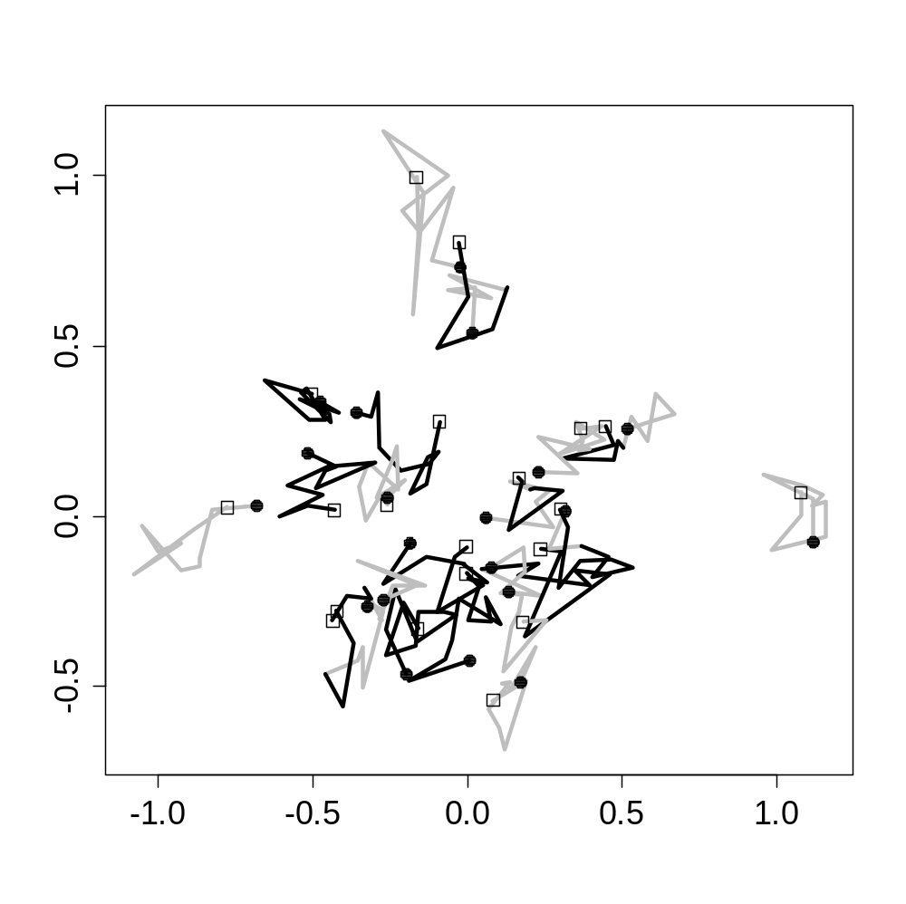
Cattle grazed
Bison grazed
First year (1998)
Last year (2008)
DCA Axis 2
DCA Axis 1

Slide 7
Site + Year
0.50 (0.46)
0.03
0.04 (0)
Site
Year
0
0.08
0
Site + Manage
0.01 (0)
Year + Manage
Manage
Site + Manage + Year
Total inertia = 1.48
R²_{CCA}= 0.63 (0.57)
Fig. 2. A Venn diagram displaying the R² (R²_{adj}) of each fraction resulting from the variation partitioning of species composition using CCA. The three factors (classes of explanatory variables) were site (S), year (Y), and management (M). Note that R² in this context does not refer to explained variance but rather explained inertia. For the shared fractions we only report the unbiased R2adj values.
Notes:
R2 R2adj
all 0.63 0.57
pl 0.50 0.46
yr 0.04 0.00
ds 0.01 0.00
plyr 0.01 0.03
plds 0.07 0.08
yrds 0.00 0.00
plyrds -0.01 0.00

Slide 8
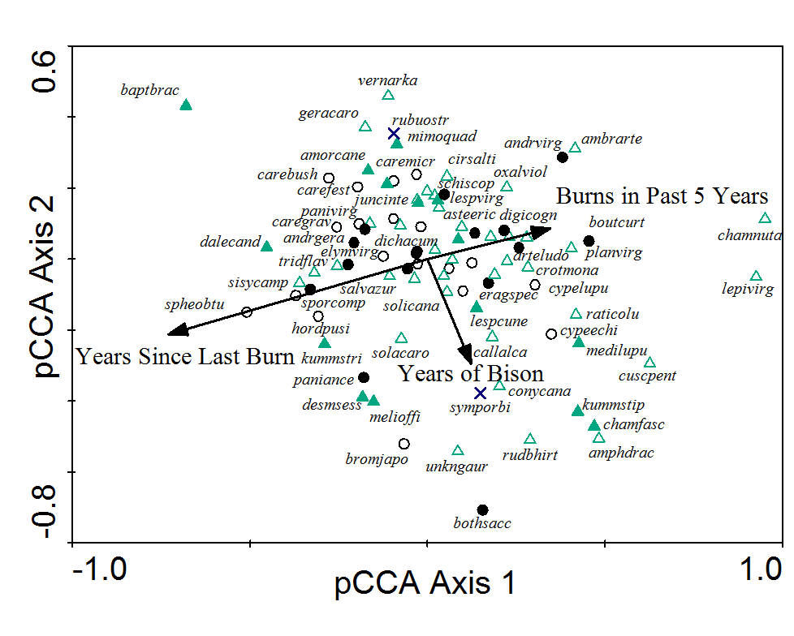
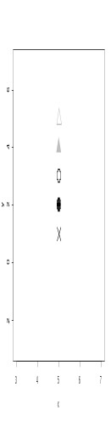

Forb
Legume
C3 graminoid
C4 graminoid
Shrub
Management variable
Notes:
x<-rep(5,5)
y<-5:1
plot(x,y,ylim=c(-3,7),pch=c(2,17,1,19,4),lwd=2,cex=3,col=c('grey','grey','black','black','black'))

Slide 9
Y ∩ S | M
0.50 (0.46)
0.03
0.04 (0)
S | Y U M
Y | S U M
0
0.08
0
S ∩ M | Y
Y ∩ M | S
0.01 (0)
M | S U Y
S ∩ M ∩ Y
Total inertia = 1.48
R² = 0.63 (0.57)
Fig. 2. A Venn diagram displaying the R² (R²_{adj}) of each fraction resulting from the variation partitioning of species composition using CCA. The three factors (classes of explanatory variables) were site (S), year (Y), and management (M). Note that R² in this context does not refer to explained variance but rather explained inertia. For the shared fractions we only report the unbiased R2adj values.
Notes:
R2 R2adj
all 0.63 0.57
pl 0.50 0.46
yr 0.04 0.00
ds 0.01 0.00
plyr 0.01 0.03
plds 0.07 0.08
yrds 0.00 0.00
plyrds -0.01 0.00

Slide 10
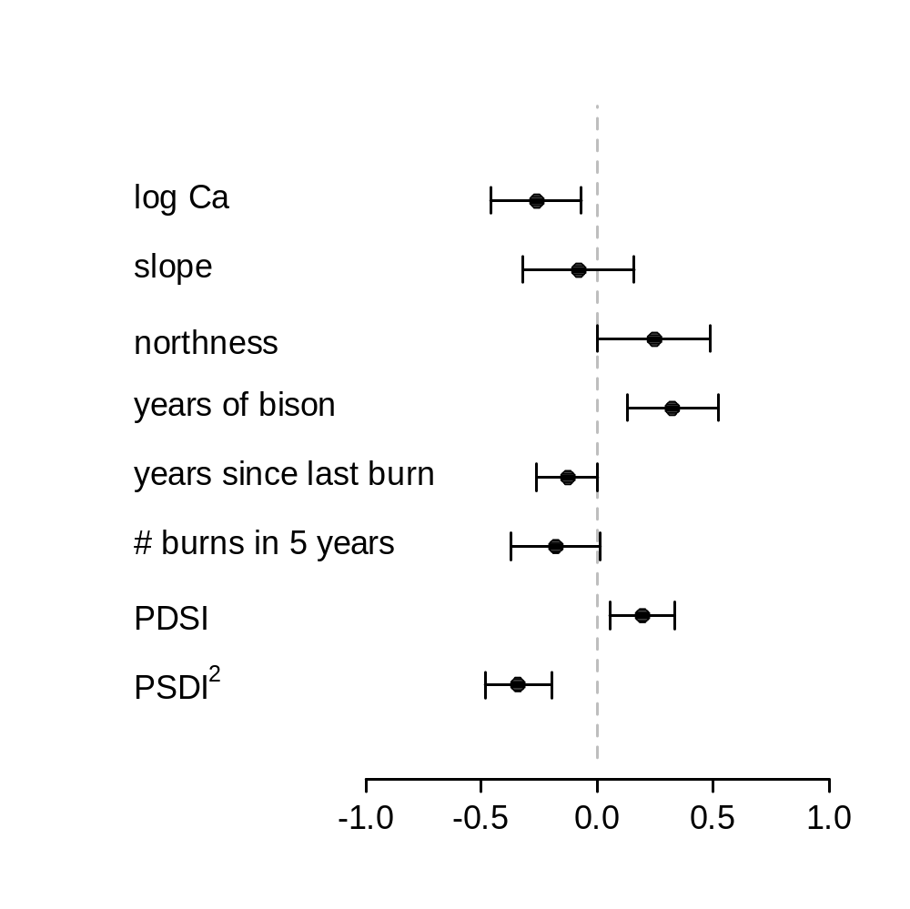
Correlation Structure: Rational quadratic spatial correlation
Formula: ~yr | name
Parameter estimate(s):
range nugget
6.9443484 0.4995376
95% confidence intervals for the partial standardized coefficients
delta AIC
exp 26.0399119
gau 39.5114399
lin 39.8527250
ratio 26.2076774
sph 39.8527250
expN 0.3146542
gauN 0.8440980
linN 41.8527250
ratioN 0.0000000
sphN 0.4532282
Notes:
Instead of hier part we can simply display the partial standardized coefficients

Slide 11
The Nature Conservancy’s
Tallgrass Prairie Preserve, Osage Co., OK, USA
Bison Unit
Mesonet tower
N
Bison
Transition
Cattle
0
5
10
15 km
Preserve Area ≈ 15,700 ha
Bison Unit Area ≈ 8,500 ha (54%)*
Figure #. A map of the Tallgrass Prairie Preserve. The shaded area denotes the bison unit which increased in area during the duration of the study. The twenty quadrats sampled each year of this study are displayed on the map. The sites that were originally bison are displayed with filled triangles (▲), those that transitioned during the study from cattle to bison are denoted by unfilled triangles (Δ), and the other cattle samples are denoted by unfilled circles (○). *Area of bison unit is as of May 1, 2008.

Slide 12
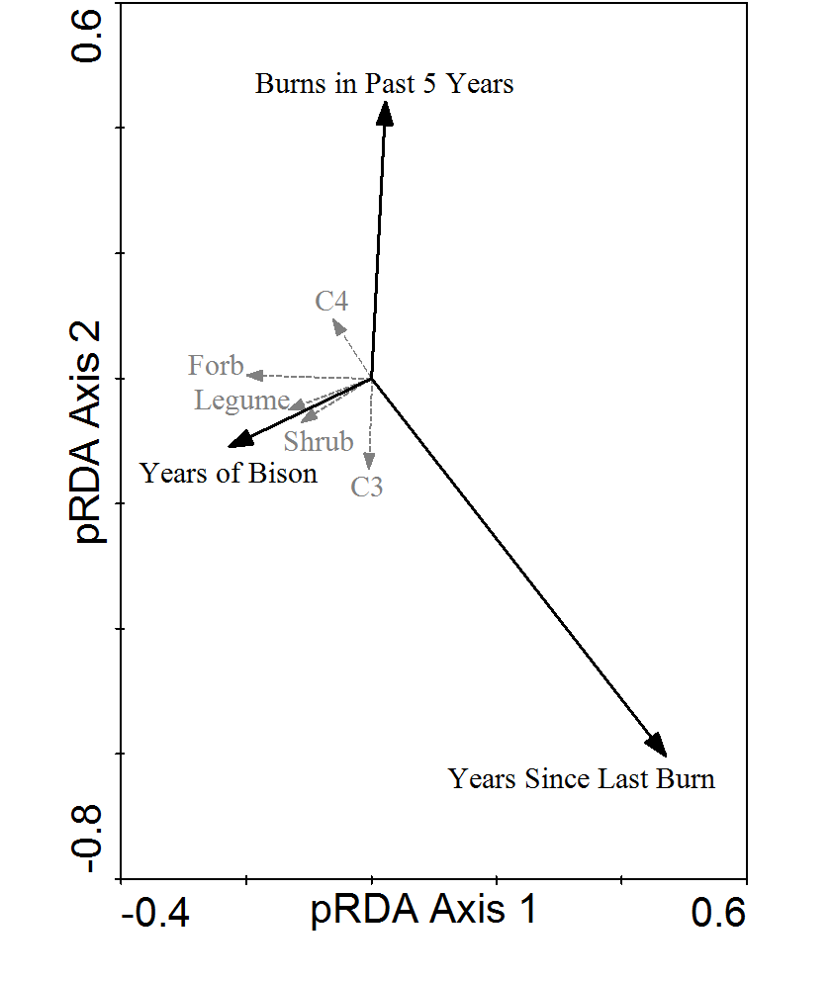
Functional group
Management variable
pRDA on functional group richness after factoring out site and yr effects

Slide 13
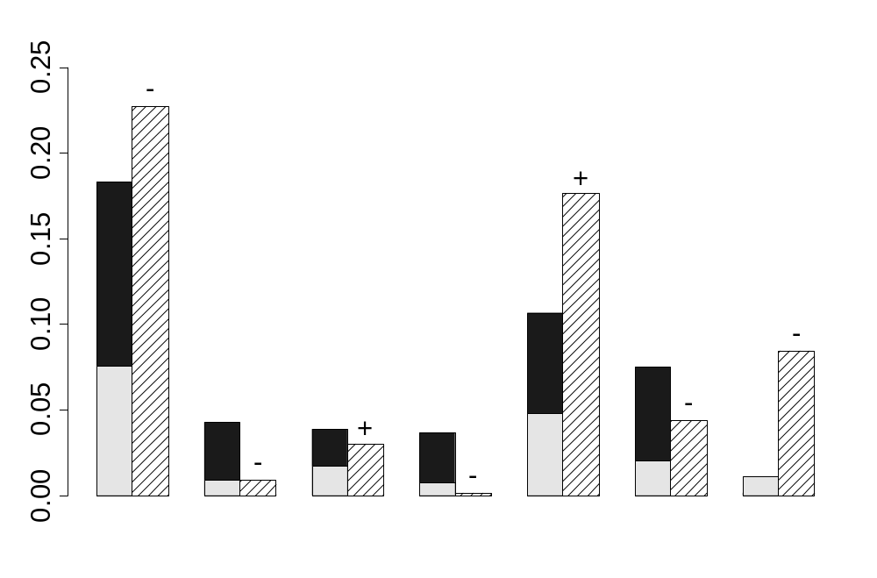
Hierarchical Partitioning
Spatial variables
Temporal variable
Management variables
Explained Variance
log Ca
slope
northness
PDSI
years of bison
# burns in 5 years
years since last burn

Slide 14
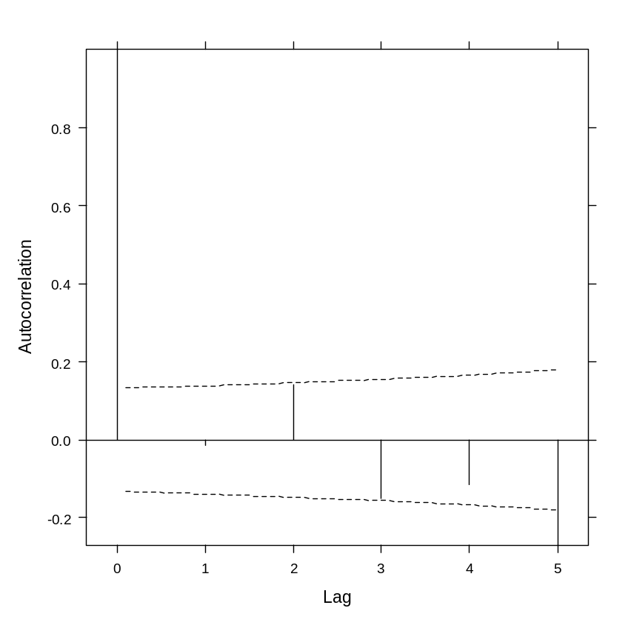
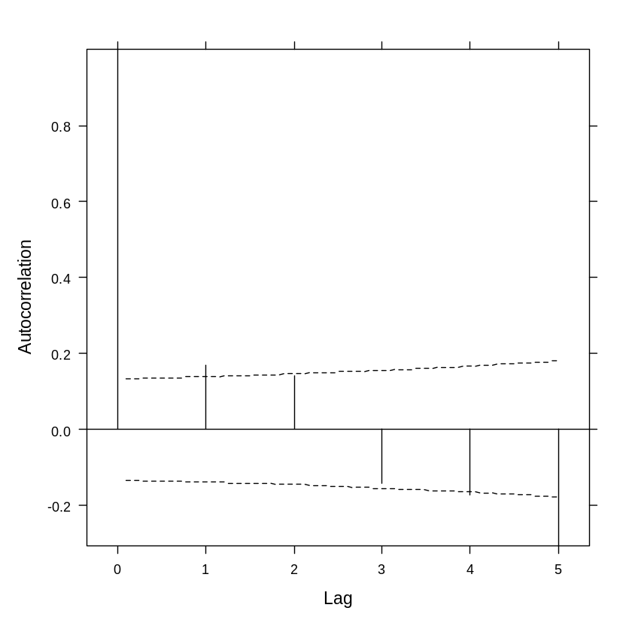
GLS(rich~name+yr+dist) + AR1(~yr|name)
Raw residuals
Normalized residuals

Slide 15
OLS
Estimate Std. Error t value Pr(>|t|)
dist.mYrsOB 1.4675 0.3127 4.693 5.22e-06 dist.mBP5Yrs -2.3475 0.7484 -3.137 0.001986
dist.mYrsSLB -1.0571 0.3349 -3.156 0.001865
dist.mbison -4.1985 1.9850 -2.115 0.035752
GLS
Value Std.Error t-value p-value
dist.mYrsOB 1.44133 0.347782 4.144360 0.0001
dist.mBP5Yrs -2.06256 0.793810 -2.598307 0.0101
dist.mYrsSLB -0.98833 0.347543 -2.843772 0.0050
dist.mbison -4.49469 2.143250 -2.097137 0.0373
Notes:
--Here is a variation partitioning on richness with yr site and disturbance, I performed the analysis in 2 ways: OLS and GLS (generalized least square)
--The GLS result must be reported as a pseudo R² value because I incorporated a single autoregressive term in the model and I’m not sure if it is reasonable to calculated sums of squares for the residual and explained variance. The pseudo R2 was calculated using the following formula:
pR2 = 1 – (L(zero)/L(theta))^2/n where L(zero) is the likelihood of the model with just an intercept term, L(theta) is the likelihood of the model with all parameters and n is the number of data points

Slide 16
Generalized least squares fit by maximum likelihood
Model: rich ~ -1 + name + yr.f + dist.m
Data: NULL
AIC BIC logLik
1479.970 1602.14 -703.9848
Correlation Structure: AR(1)
Formula: ~yr | name
Parameter estimate(s):
Phi
0.1548309
Coefficients:
Value Std.Error t-value p-value
…
dist.mYrsOB 1.44133 0.347782 4.144360 0.0001
dist.mBP5Yrs -2.06256 0.793810 -2.598307 0.0101
dist.mYrsSLB -0.98833 0.347543 -2.843772 0.0050
dist.mbison -4.49469 2.143250 -2.097137 0.0373
…
Residual standard error: 6.001573
Degrees of freedom: 220 total; 186 residual
ANOVA table, tests are marginal tests
Denom. DF: 186
numDF F-value p-value
name 20 50.97159 <.0001
yr.f 10 10.51390 <.0001
dist.m 4 6.43325 1e-04

Slide 17
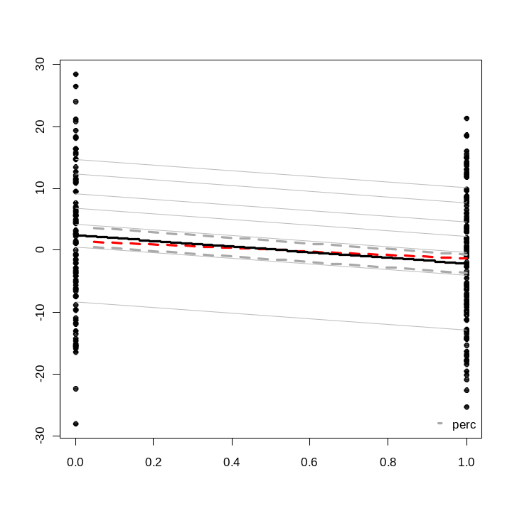
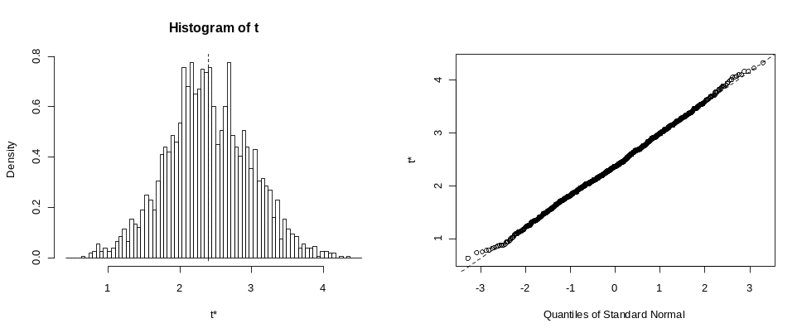
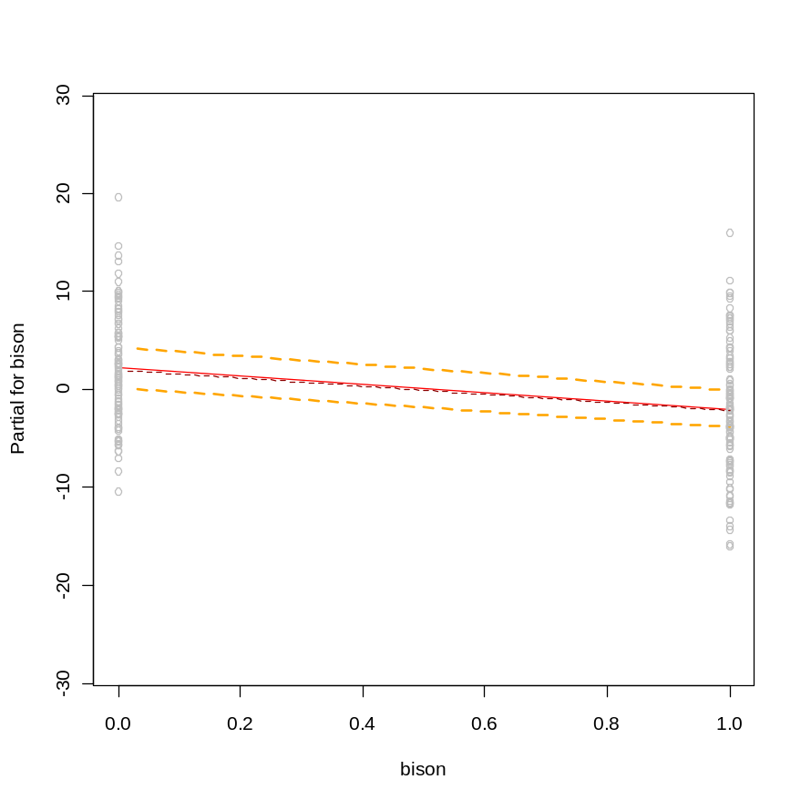
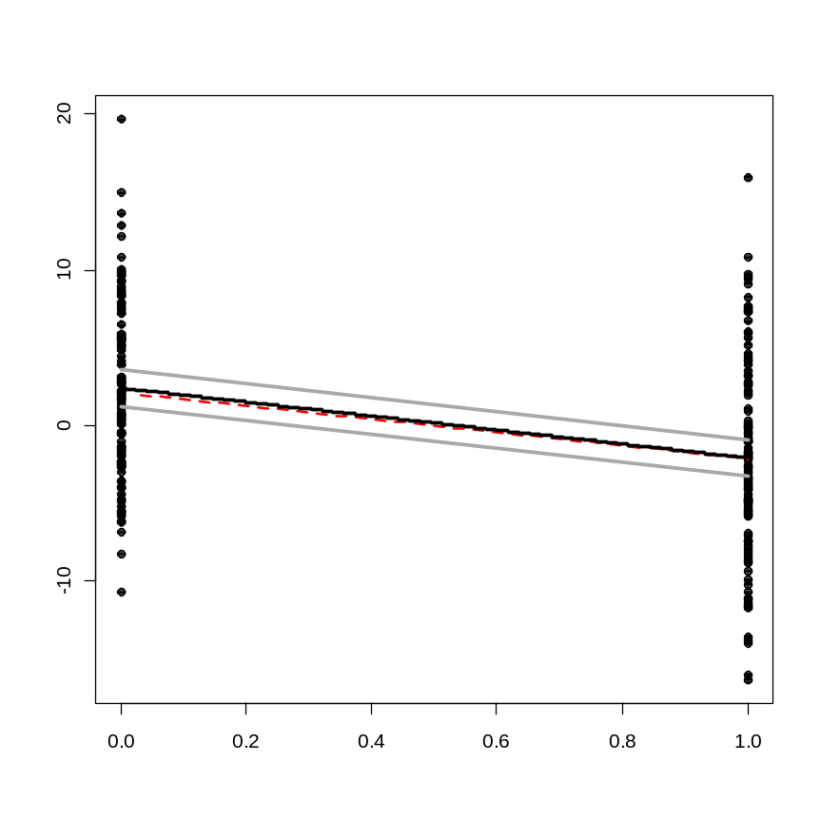
This is the least supported dist relationship, but note that permutations within sites still results in a pvalue of 0.001 or 0.004 (torus rotation) that the slope is significantly different than permuted x model results

Slide 18
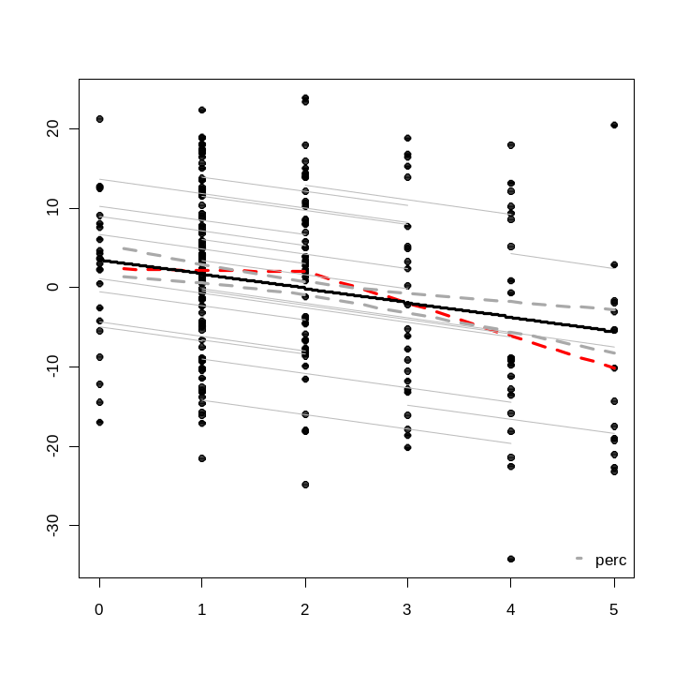
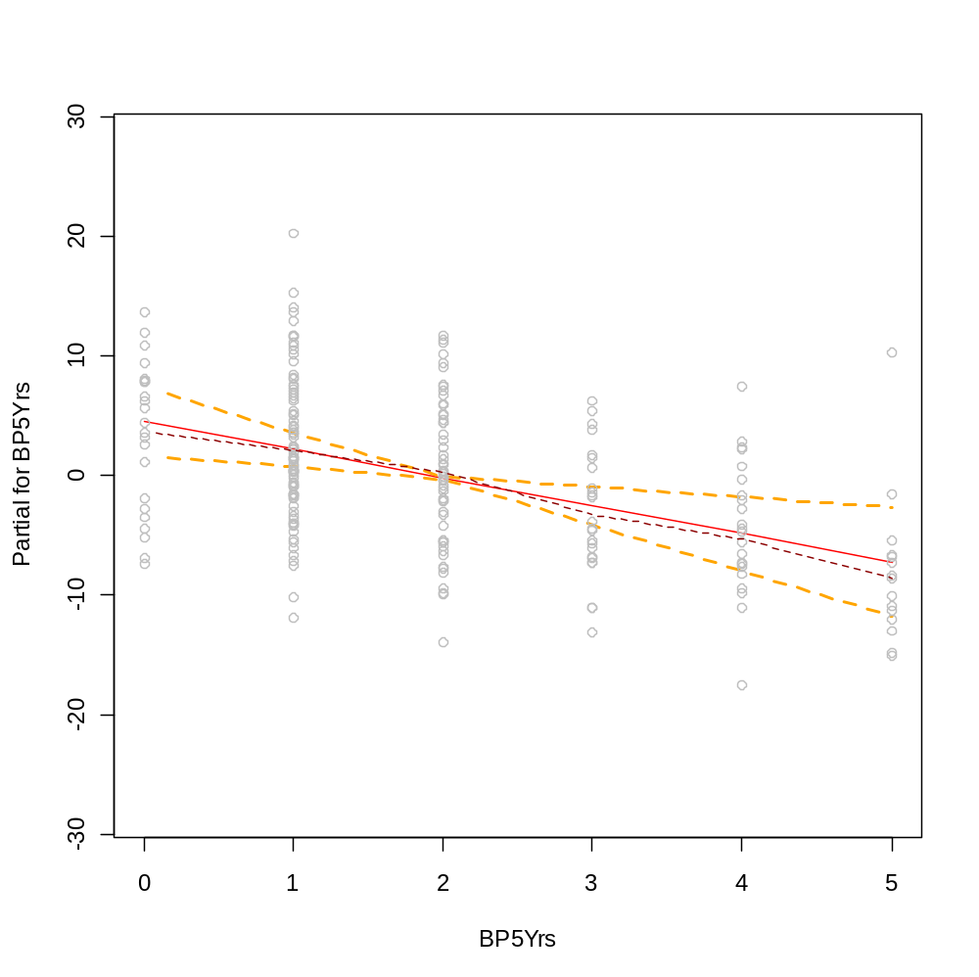
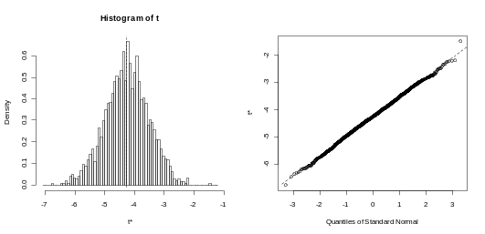
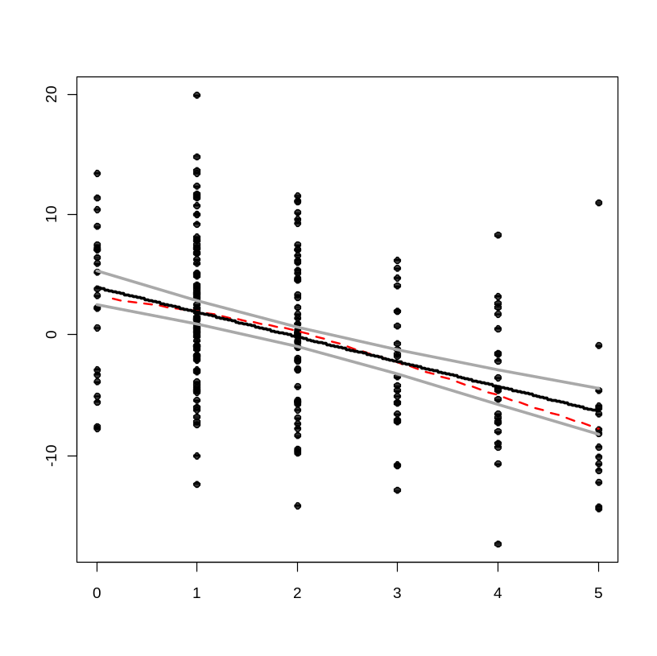

Slide 19
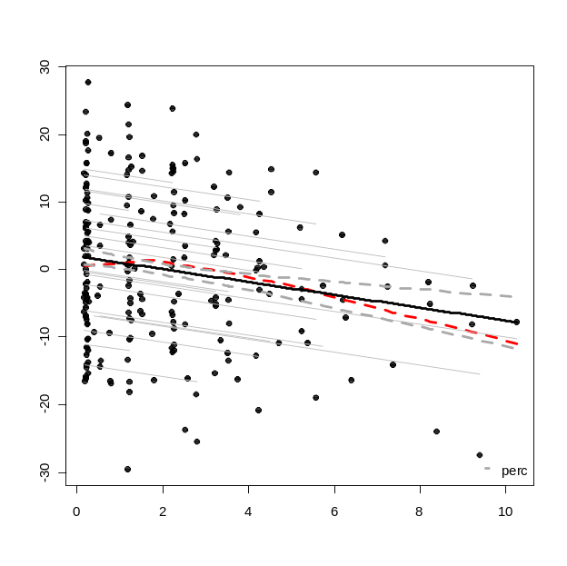
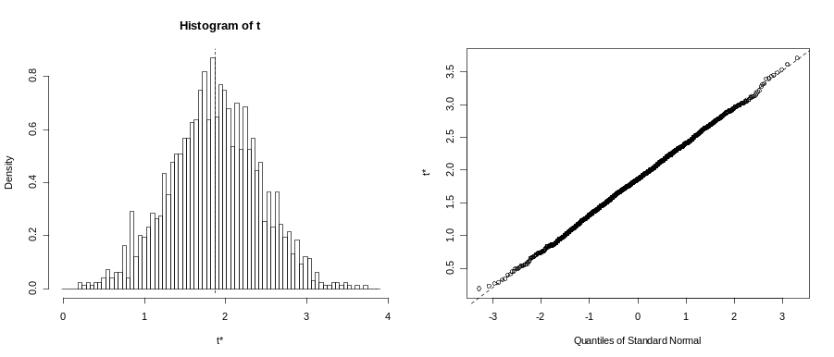
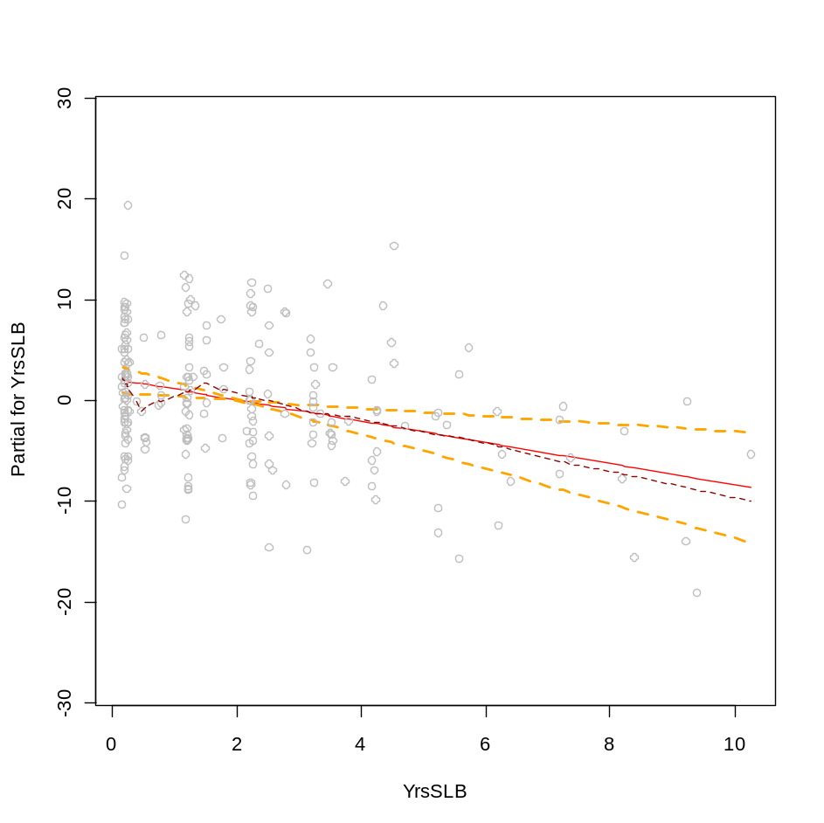
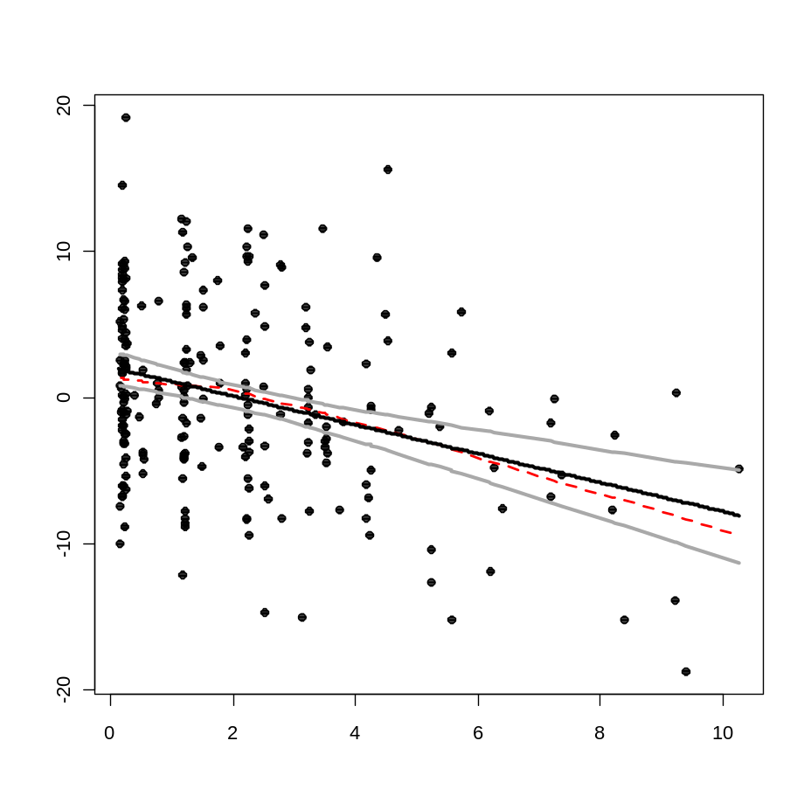

Slide 20
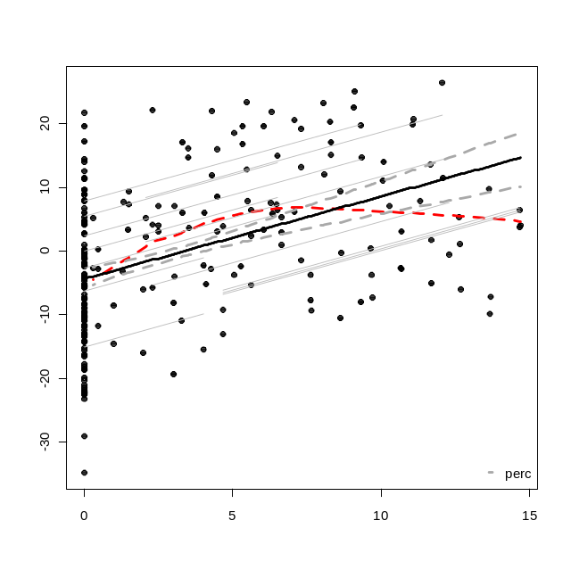
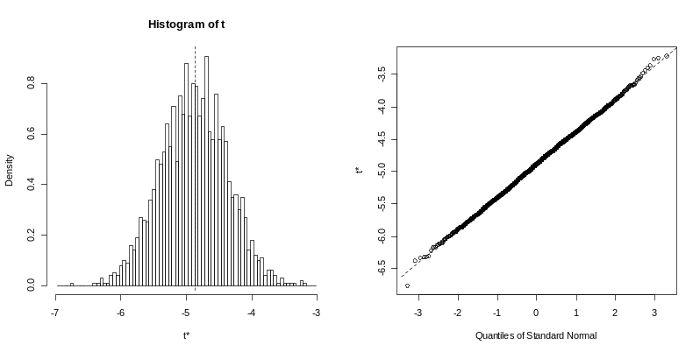
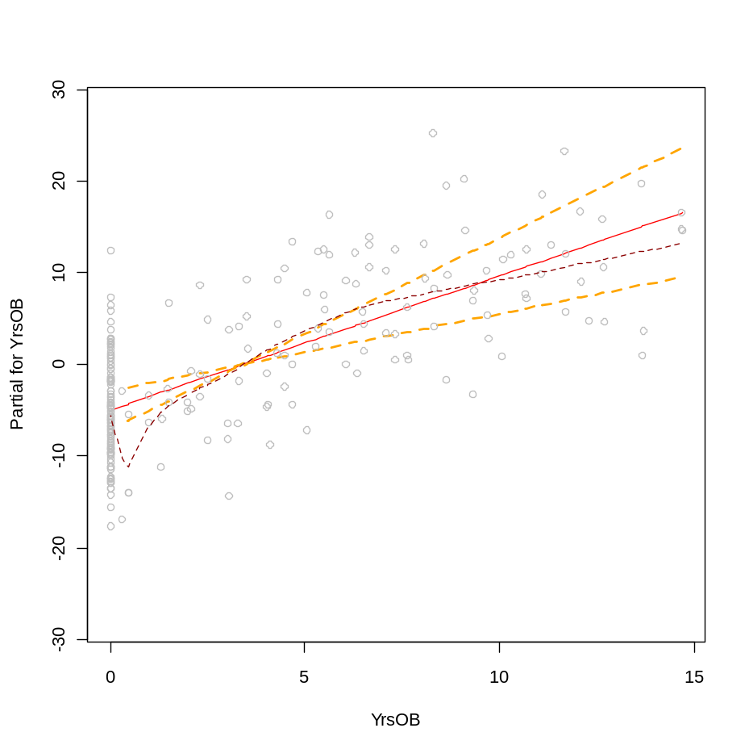
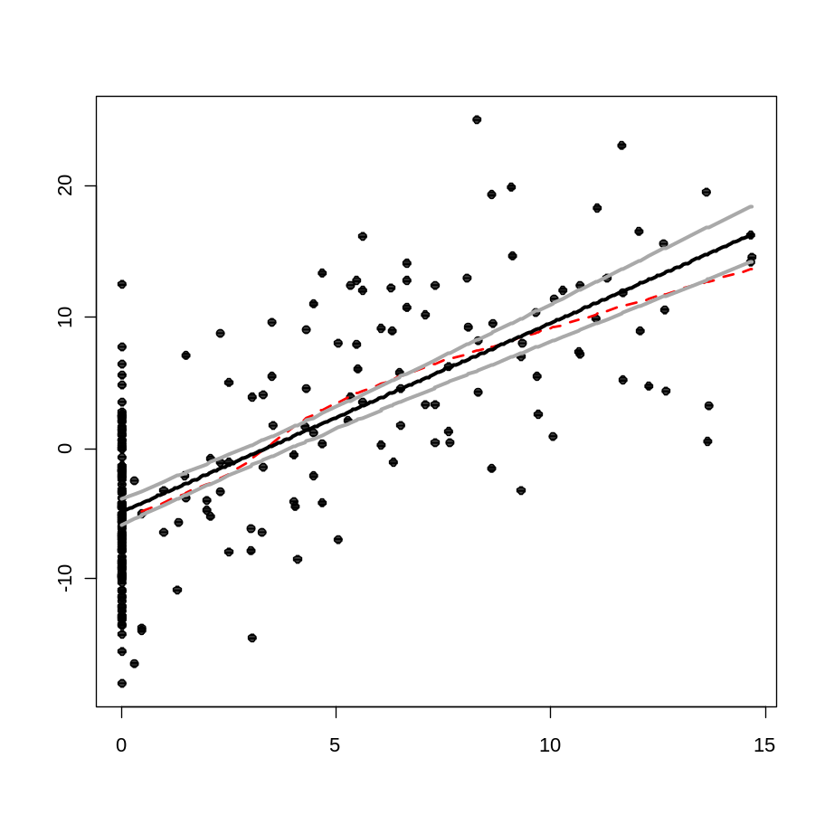
This is statistically better fit by a parabola, but the degree of scatter and potential high leverage of a few points made kept me from introducing a squared term into the model.

Slide 21
Generalized least squares fit by maximum likelihood
Model: resids ~ YrsOB + bison + YrsSLB + BP5Yrs + logCa.avg + northness
Data: NULL
AIC BIC logLik
566.0166 596.5592 -274.0083
Correlation Structure: AR(1)
Formula: ~yr | name
Parameter estimate(s):
Phi
-0.4352804
Coefficients:
Value Std.Error t-value p-value
(Intercept) 5.666311 0.9649477 5.872144 0.0000
YrsOB 0.022202 0.0157758 1.407358 0.1608
bison 0.169601 0.1359101 1.247894 0.2134
YrsSLB -0.149542 0.0302531 -4.943042 0.0000
BP5Yrs -0.194756 0.0520874 -3.739024 0.0002
logCa.avg -1.505124 0.2875772 -5.233809 0.0000
northness 0.100541 0.0597362 1.683091 0.0938
Generalized least squares fit by maximum likelihood
Model: resids ~ YrsOB + bison + YrsSLB + BP5Yrs + rain.tot * temp.avg
Data: NULL
AIC BIC logLik
598.3803 632.3166 -289.1902
Correlation Structure: AR(1)
Formula: ~yr | name
Parameter estimate(s):
Phi
0.03994276
Coefficients:
Value Std.Error t-value p-value
(Intercept) 50.90194 9.387306 5.422422 0.0000
YrsOB 0.09754 0.023439 4.161374 0.0000
bison -0.60623 0.202837 -2.988780 0.0031
YrsSLB -0.08726 0.041771 -2.088897 0.0379
BP5Yrs -0.13847 0.074002 -1.871114 0.0627
rain.tot -0.48831 0.094112 -5.188564 0.0000
temp.avg -3.36185 0.630076 -5.335635 0.0000
rain.tot:temp.avg 0.03244 0.006291 5.155877 0.0000

Slide 22

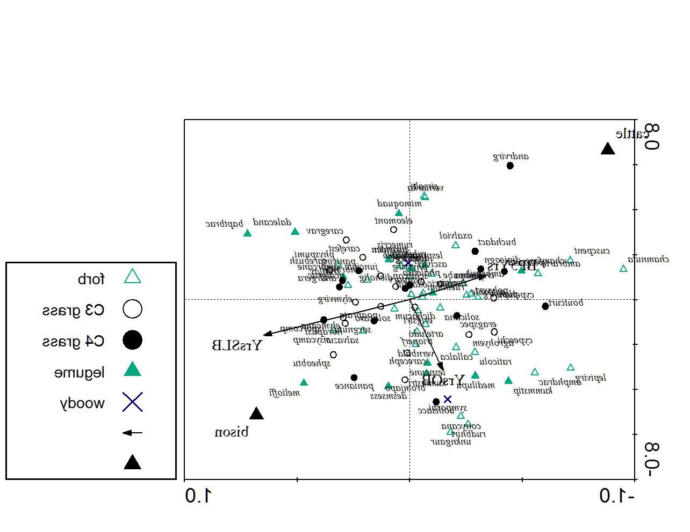
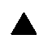
Forb
Legume
C3 graminoid
C4 graminoid
Shrub
Grazer dummy variable
Continuous variable

Slide 23
Linear mixed-effects model fit by maximum likelihood
Data: NULL
AIC BIC logLik
1538.43 1589.334 -754.215
Random effects:
Formula: ~1 | name
(Intercept) Residual
StdDev: 5.192534 0.01942729
Correlation Structure: AR(1)
Formula: ~yr | name
Parameter estimate(s):
Phi
0.2301598
Variance function:
Structure: Power of variance covariate
Formula: ~fitted(.)
Parameter estimates:
power
1.365676
Fixed effects: rich ~ cyr + cyr2 + logCa.avg + YrsOB + bison + YrsSLB + BP5Yrs + rain.tot * temp.avg
Value Std.Error DF t-value p-value
(Intercept) 643.1845 78.73337 191 8.169147 0.0000
cyr 0.6151 0.21897 191 2.809166 0.0055
cyr2 -0.2079 0.07182 191 -2.894697 0.0042
logCa.avg -41.0694 8.28331 18 -4.958093 0.0001
YrsOB 1.4387 0.30364 191 4.738115 0.0000
bison -3.7367 2.04328 191 -1.828801 0.0690
YrsSLB -1.1284 0.37563 191 -3.003960 0.0030
BP5Yrs -2.0855 0.75546 191 -2.760605 0.0063
rain.tot -4.0613 0.73781 191 -5.504592 0.0000
temp.avg -28.4800 4.91873 191 -5.790107 0.0000
rain.tot:temp.avg 0.2739 0.04899 191 5.591655 0.0000
Bonferonni p-value for 10 tests is 0.005,
We don’t care about the intercept test
T-table for Standardized explanatory variables
Value Std.Error DF t-value p-value
(Intercept) 79.78311 1.9745668 191 40.40538 0.0000
syr 1.94966 0.6940367 191 2.80916 0.0055
syr2 -2.08844 0.7214706 191 -2.89470 0.0042
slogca -6.86630 1.3848676 18 -4.95809 0.0001*
syob 6.10048 1.2875331 191 4.73811 0.0000*
bison -3.73674 2.0432768 191 -1.82880 0.0690
syslb -2.41291 0.8032441 191 -3.00396 0.0030
sbp5 -2.88805 1.0461689 191 -2.76060 0.0063
srain -1.46712 0.7227335 191 -2.02995 0.0437
stemp -1.56596 0.4597763 191 -3.40591 0.0008*
srain:stemp 3.59099 0.6422047 191 5.59166 0.0000*

Slide 24
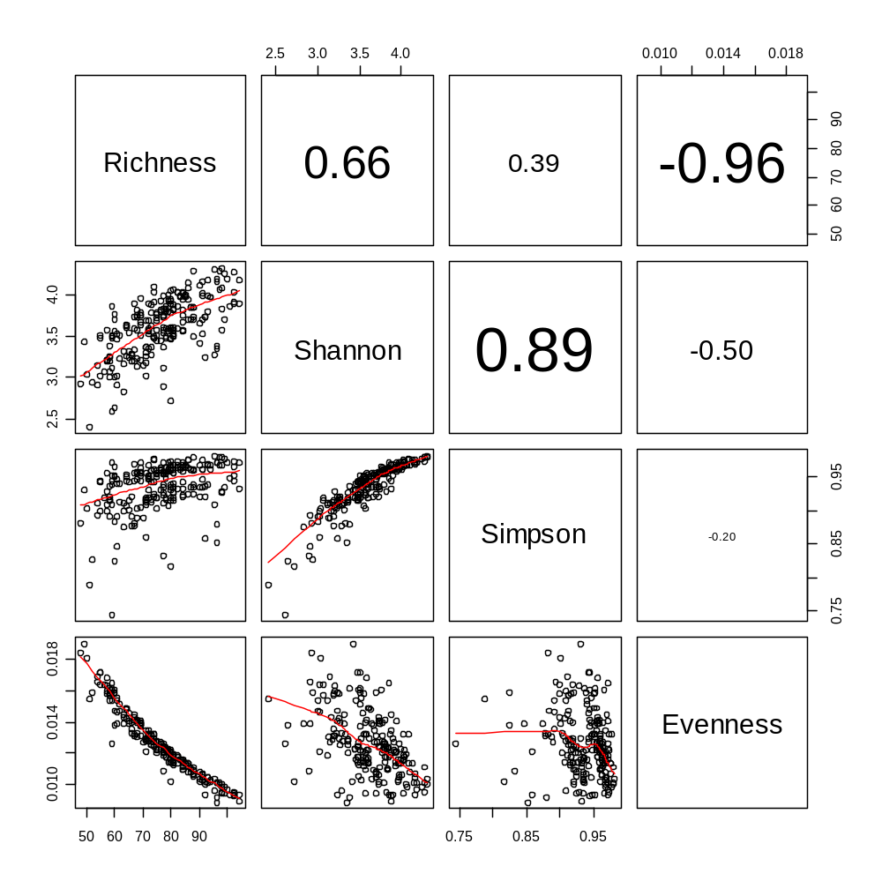
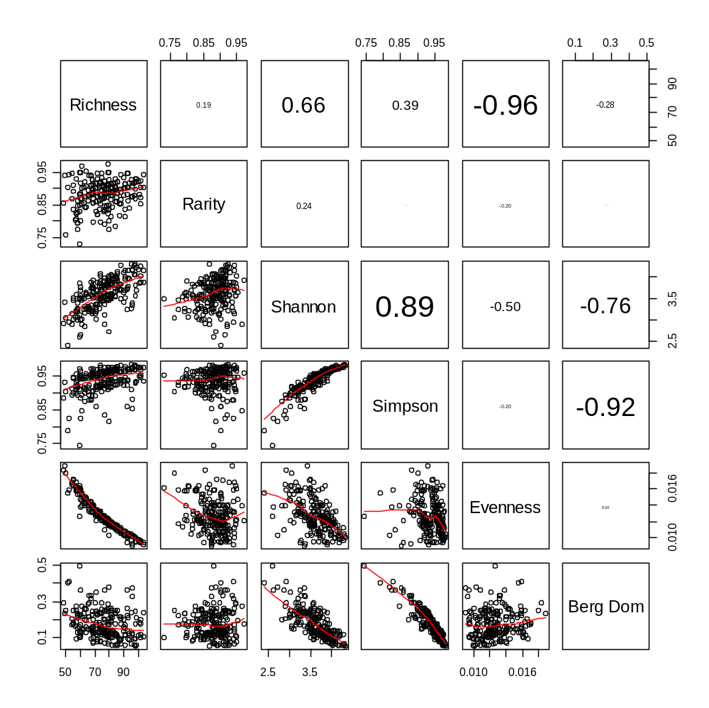
Diversity Indices

Slide 25
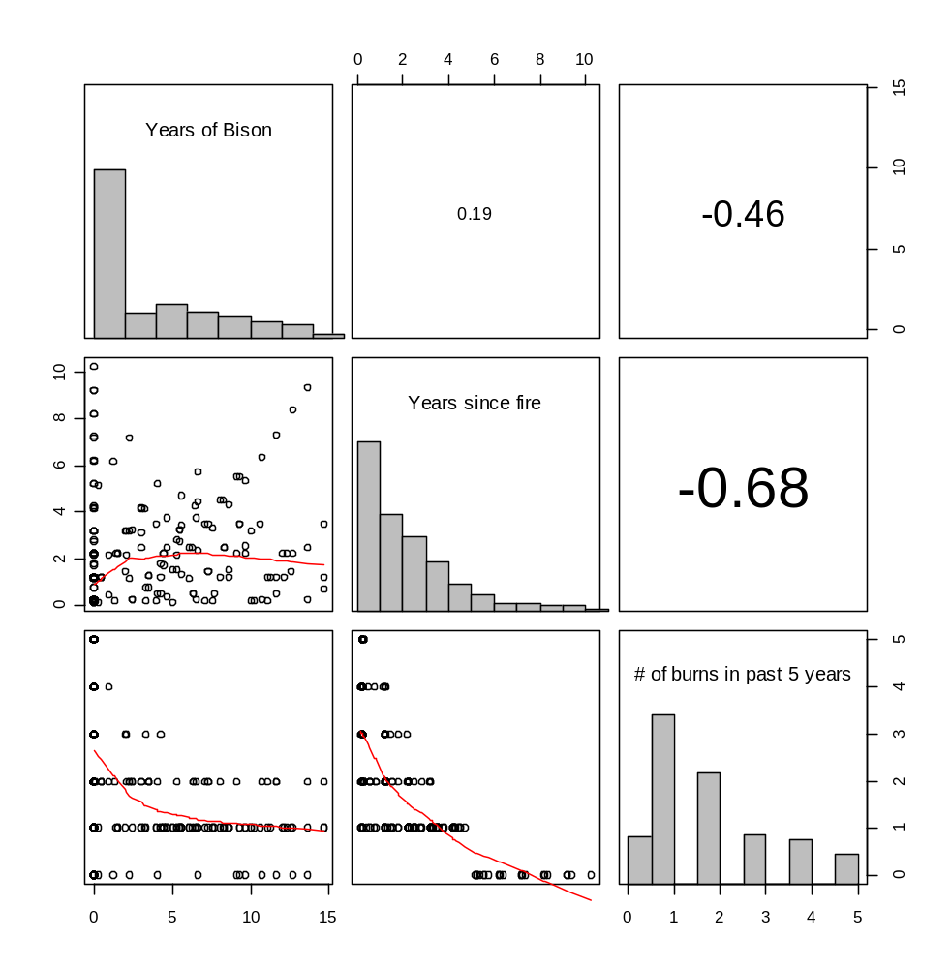
Explanatory Variables

Slide 26
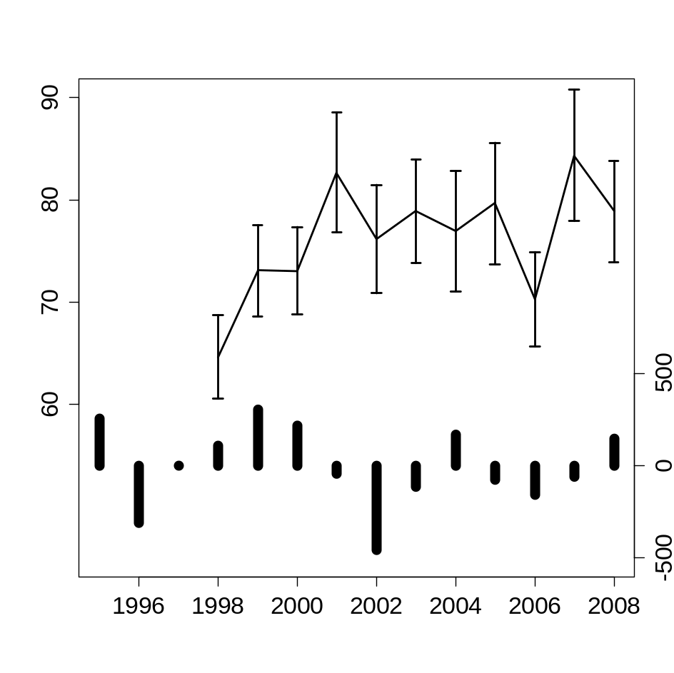

Mean species richness at 100 m²
Annual precipitation deviation (mm)
Year
Fig. 1. The mean species richness at the largest sampling grain (100 m²) for the 20 permanent quadrats through time and the deviation in annual precipitation (mm) from the 13-year average (1995-2008). The mean richness values include 95% confidence intervals ( ± 1.96*SE). Note that study site specific climate data (i.e. Mesonet data) does not exist before 1995.
Notes:
--This graphic is not mandatory for the manuscript but it may be nice to include anyways. I think it goes a long way towards showing the reader the length of our study an idea about the degree of site-to-site variation in richness (the error bars) as well as temporal variation.
--Bootstrap confidence intervals were also constructed and they almost completely agreed with the parametric confidence intervals displayed above (the bootstraped ones were slightly more conservative but the difference was usually very small). A criticism of parametric error bars is that some years did have skewed distributions of richness, but the strong agreement with the bootstrap values seems to show that this is not a big deal. An alternative way to display this result would be with box and whisker plots, I’ve constructed this graphic as well and could send it to you if you think you’d like to take a look.
--I included the precipitation information here in part because Adler & Levine did so in their 2008 Oikos pub looking at grassland plant richness through time, but more importantly because the rainfall is somewhat cyclical (I tried to looking into whether or not this corresponds with el nino/la nina events but came up short) and it seems visually like richness may correlate with total rainfall on a 2-year lag interval. This is interesting but not the focus of our 11-yr study which I think is too short to short out climatic drivers for the time being.

Slide 27
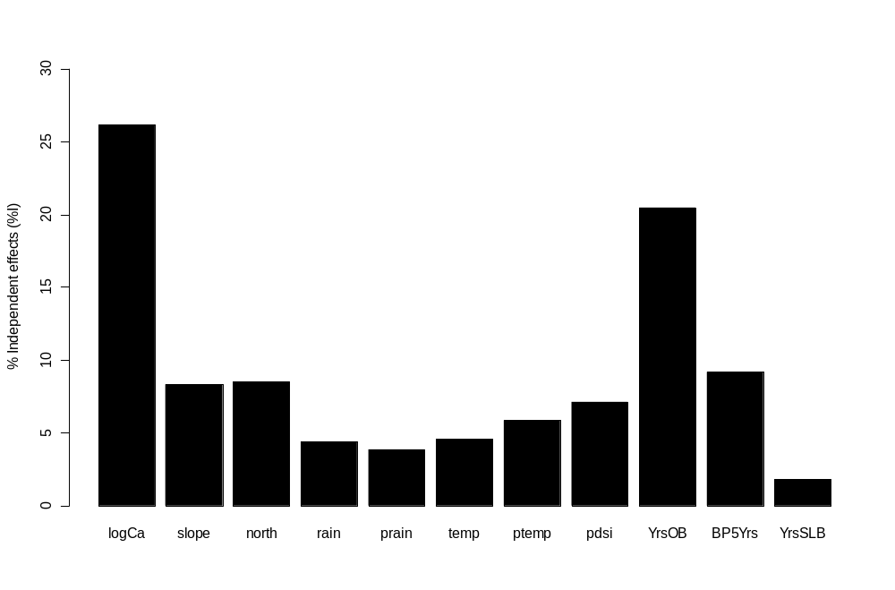
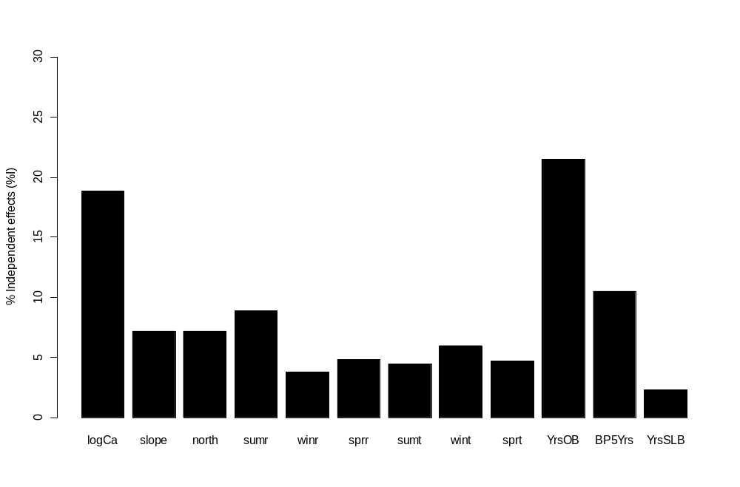

Slide 28
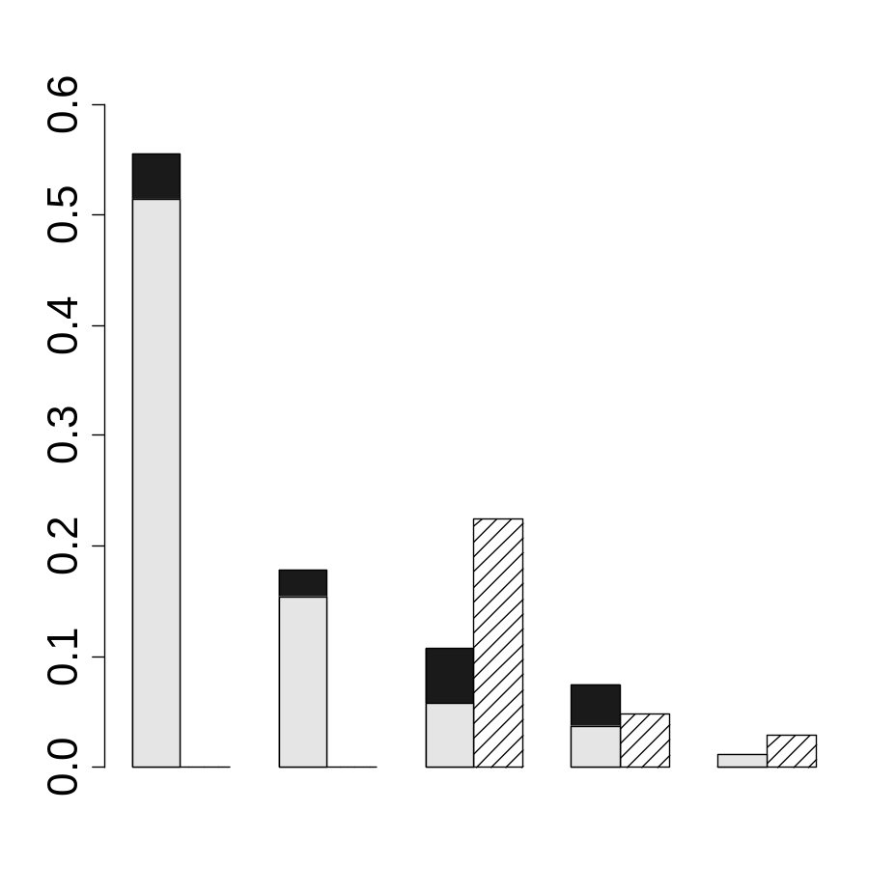
More hier.part
Plotid yrear yrbison bp5 yrslb

Slide 29
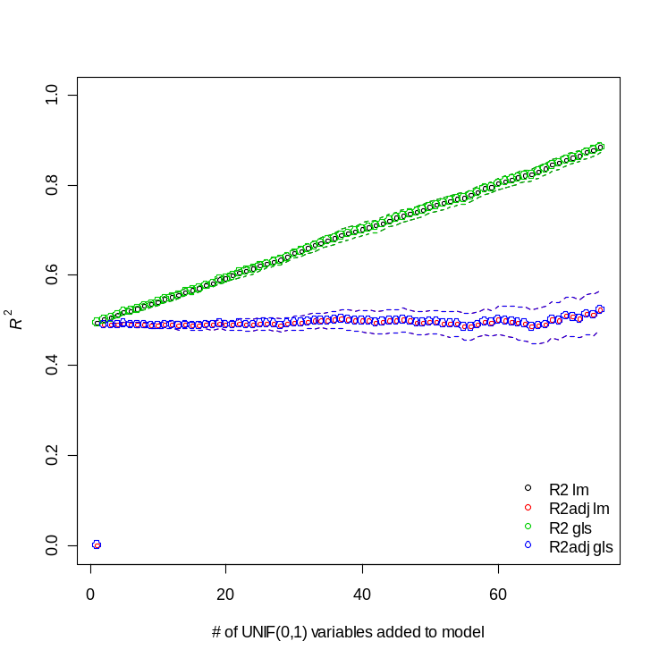
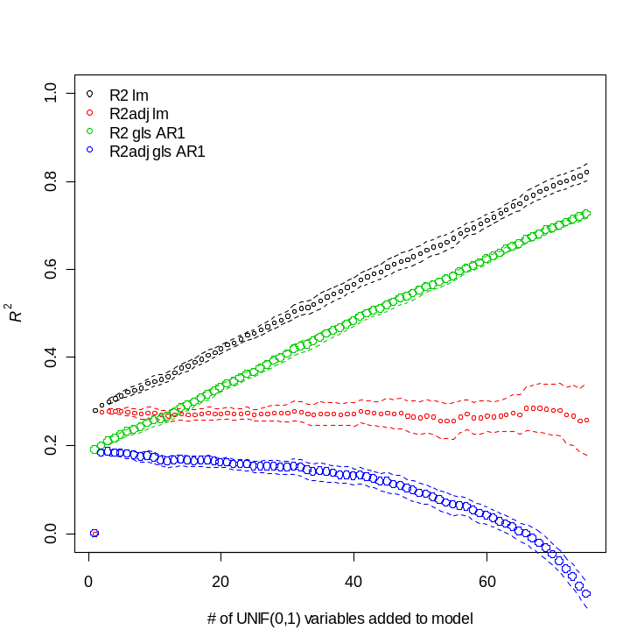
Adjusted generalized R2

Slide 30
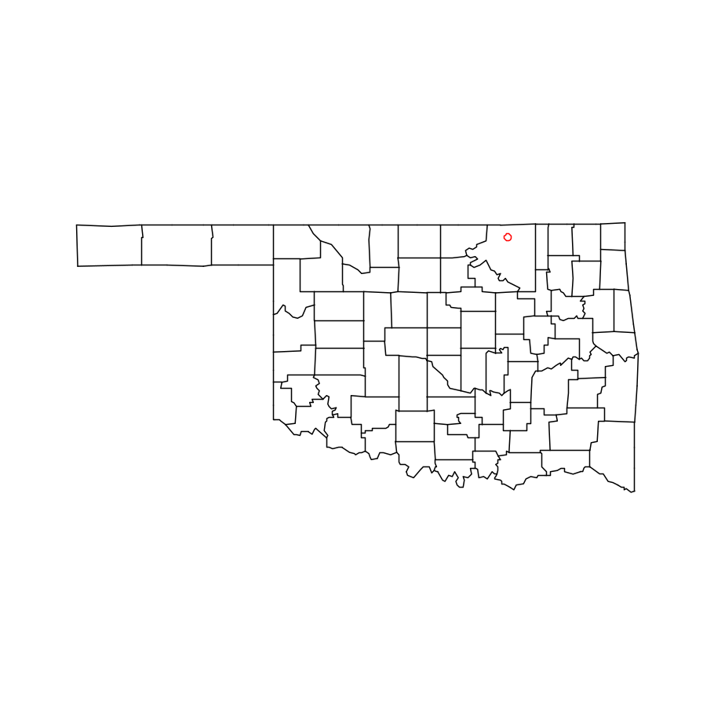

Equation slide

Slide 31
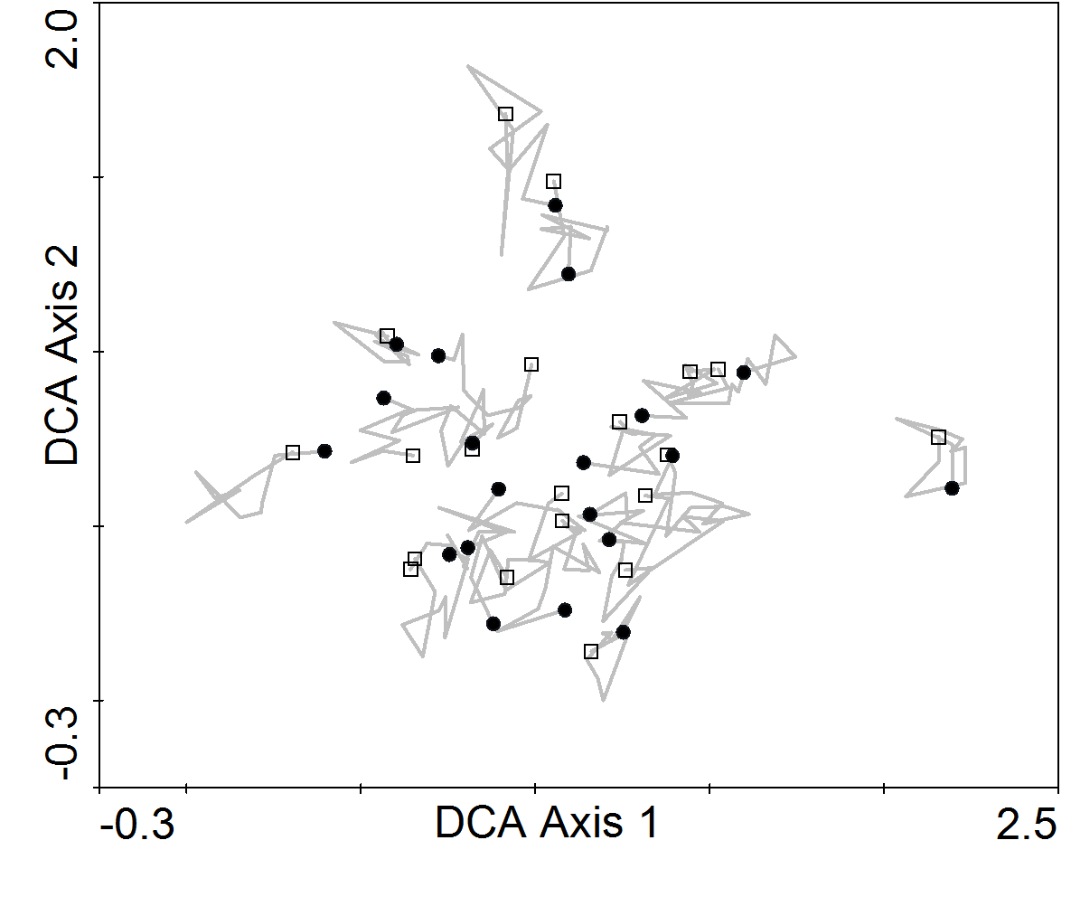

Slide 32
 | Number of Burns |  | Average Years Since Last Burn
Year | traditional | dynamic | traditional | dynamic
1998 | 9 | 1 | 1.2 | 2.5
1999 | 6 | 0 | 1.3 | 3.5
2000 | 6 | 3 | 1.5 | 3.2
2001 | 7 | 3 | 1.4 | 2
2002 | 5 | 2 | 1.7 | 1.8
2003 | 5 | 1 | 2 | 2.5
2004 | 3 | 3 | 2.6 | 2.7
2005 | 6 | 5 | 1.3 | 2.3
2006 | 3 | 2 | 1.8 | 2.3
2007 | 0 | 2 | 2.9 | 2.8
2008 | 5 | 3 | 2.1 | 2.3
Average | 5.0 | 2.3 | 1.8 | 2.5
 | Number of Samples |  | Number of Burns |  | Average Years Since Last Burn
Year | traditional | dynamic | traditional | dynamic | traditional | dynamic
1998 | 14 | 6 | 9 | 1 | 1.2 (1.3) | 2.5 (1.3)
1999 | 14 | 6 | 6 | 0 | 1.3 (1.3) | 3.5 (1.2)
2000 | 12 | 8 | 6 | 3 | 1.5 (1.3) | 3.2 (1.2)
2001 | 12 | 8 | 7 | 3 | 1.4 (1.3) | 2.0 (1.3)
2002 | 12 | 8 | 5 | 2 | 1.7 (1.3) | 1.8 (1.3)
2003 | 9 | 11 | 5 | 1 | 2.0 (1.3) | 2.5 (1.2)
2004 | 9 | 11 | 3 | 3 | 2.6 (1.2) | 2.7 (1.2)
2005 | 7 | 13 | 6 | 5 | 1.3 (1.4) | 2.3 (1.2)
2006 | 7 | 13 | 3 | 2 | 1.8 (1.3) | 2.3 (1.2)
2007 | 7 | 13 | 0 | 2 | 2.9 (1.3) | 2.8 (1.2)
2008 | 7 | 13 | 5 | 3 | 2.1 (1.3) | 2.3 (1.2)
Average | 10.0 | 10.0 | 5.0 | 2.3 | 1.8 (1.1) | 2.5 (1.1)
Year | traditional | dynamic | traditional | dynamic | traditional | dynamic
1998 | 14 | 6 | 9 | 1 | 1.2 (±1.28) | 2.5 (±1.29)
1999 | 14 | 6 | 6 | 0 | 1.3 (±1.27) | 3.5 (±1.24)
2000 | 12 | 8 | 6 | 3 | 1.5 (±1.27) | 3.2 (±1.22)
2001 | 12 | 8 | 7 | 3 | 1.4 (±1.28) | 2 (±1.29)
2002 | 12 | 8 | 5 | 2 | 1.7 (±1.25) | 1.8 (±1.3)
2003 | 9 | 11 | 5 | 1 | 2 (±1.27) | 2.5 (±1.21)
2004 | 9 | 11 | 3 | 3 | 2.6 (±1.23) | 2.7 (±1.2)
2005 | 7 | 13 | 6 | 5 | 1.3 (±1.39) | 2.3 (±1.2)
2006 | 7 | 13 | 3 | 2 | 1.8 (±1.32) | 2.3 (±1.2)
2007 | 7 | 13 | 0 | 2 | 2.9 (±1.25) | 2.8 (±1.18)
2008 | 7 | 13 | 5 | 3 | 2.1 (±1.3) | 2.3 (±1.2)
Average | 10.0 | 10.0 | 5.0 | 2.3 | 1.8 | 2.5

Slide 33
 | OLS |  |  |  | GLS
Variable Class (d.f.) |  |  | F-value | p-value |  | F-value | p-value
S | Y U M (19) | 0.48 | 0.48 | 17.69 | <0.0001 | 0.22 | 13.4791 | <0.0001
Y | S U M (10) | 0.13 | 0.13 | 9.16 | <0.0001 | 0.22 | 10.27 | <0.0001
M | S U Y (3) | 0.04 | 0.04 | 9.38 | <0.0001 | 0.04 | 7.25 | 0.0001
S ∩ Y | M | 0.01 | -0.02 |  |  | 0.15
S ∩ M | Y | 0.05 | 0.05 |  |  | 0.08
Y ∩ M | S | 0.08 | 0.07 |  |  | -0.02
S ∩ Y ∩ M | -0.01 | -0.02 |  |  | -0.05
Total (32) | 0.77 | 0.74 |  |  | 0.65

Slide 34

A
Y ∩ S | M
B
Y ∩ S | M
0.48
-0.02
0.13
48.9
0.6
4.4
S | Y U M
Y | S U M
S | Y U M
Y | S U M
-0.02
8.1
0.05
0.07
7.7
-2.2
S ∩ M | Y
Y ∩ M | S
S ∩ M | Y
Y ∩ M | S
0.04
1.9
M | S U Y
M | S U Y
S ∩ M ∩ Y
S ∩ M ∩ Y
R² = 0.77 (0.74)
Total inertia = 1.476
63% of the of inertia explained
Fig. 2. Variation and inertia partitioning for richness (A.) and species composition (B.) respectively for site (S), year (Y), and management variables (M). The inherent autocorrelation in the repeated samples was not corrected for in either analysis. The values reported in A. are the unbiased estimates (

Slide 35
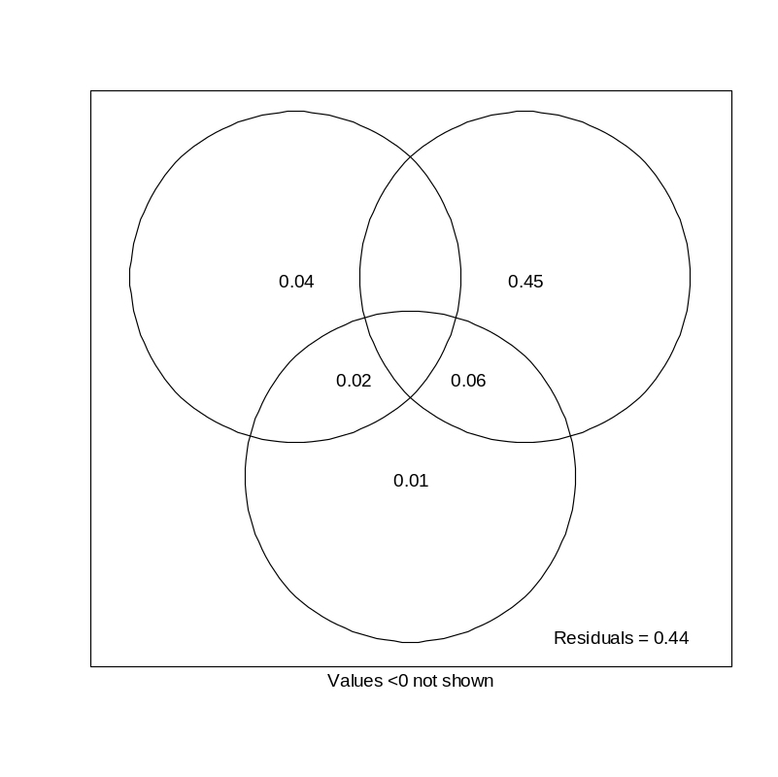
RDA adjusted fractions
 | CCA
Variable Class (q) |  |  | F- ratio | p-value
S | Y U M (19) | 0.50 | 0.46 | 13.47 | < 0.0001
Y | S U M (10) | 0.04 | 0 | 2.27 | < 0.0001
M | S U Y (3) | 0.01 | 0 | 2.15 | 0.0001
S ∩ Y | M | 0.01 | 0.03
S ∩ M | Y | 0.07 | 0.08
Y ∩ M | S | 0 | 0
S ∩ Y ∩ M | -0.01 | -0
Total (32) | 0.63 | 0.57

Slide 36
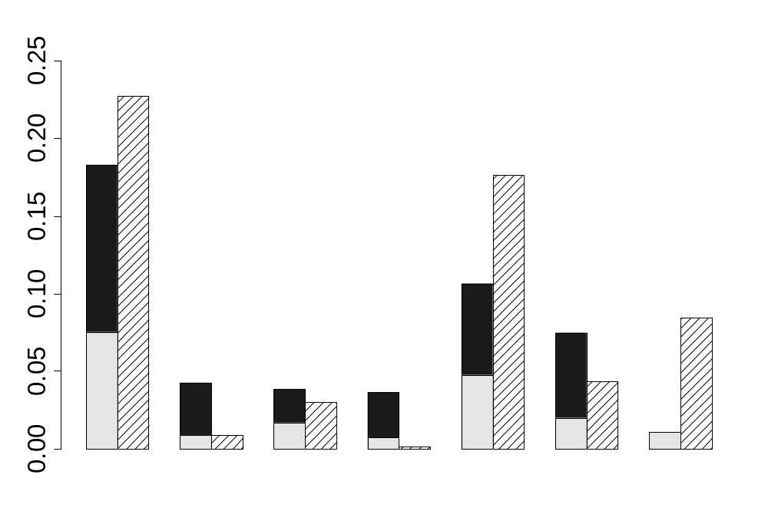
Hierarchical Partitioning
Site variables
Temporal variable
Management variables
-
+
Explained Variance
-
-
+
-
-
log Ca
slope
northern
aspect
PDSI
years of bison
# burns in 5 years
years since last burn

Slide 37
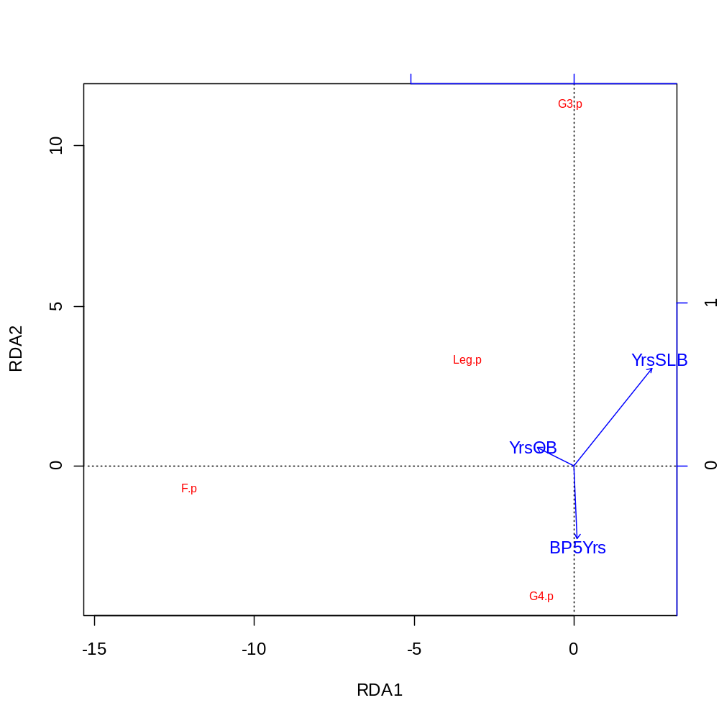

Slide 38
Explanatory Variable | Covariables | Temporal Autocorrelation Model (range, nugget) | Beta | R2 | F-ratio | p-value
General Factors
site | year & management | Gaussian (3.92, 0.55) | NA | 0.22 | 5.80 | < 0.001
year | site & management | -- | NA | 0.22 | 12.87 | < 0.001
management variables | site & year | -- | NA | 0.04 | 4.07 | 0.008
Specific Site Variables
log Ca | slope + northness + year + management | Exponential (10.91, 0.32) | -0.28 |  | 6.51 | 0.012
slope | log Ca+ northness + year + management | -- | -0.10 |  | 0.71 | 0.400
northness | log Ca + slope + year + management | -- | 0.24 |  | 3.71 | 0.056
Specific Year Variables
summer rain | winter rain + spring rain + site + management | Exponential (0.85, 0) | -0.191 |  | 26.65 | < 0.001
winter rain | summer rain + spring rain + site + management | -- | 0.151 |  | 15.47 | < 0.001
spring rain | summer rain + winter rain + site + management | -- | 0.137 |  | 11.43 | 0.001
Specific Management Variables
years of bison | years since last burn + # of burns in 5 years + site + year | Gaussian (3.92, 0.55) | 0.434 |  | 7.61 | 0.006
years since burn | years of bison + # of burns in 5 years + site + year | -- | -0.110 |  | 3.52 | 0.062
# of burns in 5 years | years of bison + years since last burn + site + year | -- | -0.105 |  | 1.34 | 0.249
Explanatory Variables | Covariables | Temporal Autocorrelation Model (range, nugget) | Beta | R2 | F-ratio | p-value
Site Variables
log Ca | slope + northness + year + management | Exponential (10.91, 0.32) | -0.28 | 0.05 | 6.51 | 0.012
slope | log Ca+ northness + year + management | -- | -0.10 | 0 | 0.71 | 0.400
northness | log Ca + slope + year + management | -- | 0.24 | 0.01 | 3.71 | 0.056
Year Variables
summer rain | winter rain + spring rain + site + management | Exponential (0.85, 0) | -0.191 | 0.03 | 26.65 | < 0.001
winter rain | summer rain + spring rain + site + management | -- | 0.151 | 0.02 | 15.47 | < 0.001
spring rain | summer rain + winter rain + site + management | -- | 0.137 | 0.01 | 11.43 | 0.001
Management Variables
years of bison | years since last burn + # of burns in 5 years + site + year | Gaussian (3.92, 0.55) | 0.434 | 0.01 | 7.61 | 0.006
years since burn | years of bison + # of burns in 5 years + site + year | -- | -0.110 | 0 | 3.52 | 0.062
# of burns in 5 years | years of bison + years since last burn + site + year | -- | -0.105 | 0 | 1.34 | 0.249

Slide 39
Table #. Variation partitioning of richness into the its components for site (S), year (Y), and management (M) variables. The site and year variables were quantified using dummy variables and the management variable include years of bison, years since last burn, and the number of burns in the past five years. The table displays the unadjusted and adjusted OLS coefficients of determination (also displayed in Fig. #), as well as, as coefficients of determination for GLS models incorporating a single autoregressive terms.
 | OLS |  |  | GLS (AR1)
Variable Class (q) |  |  |  |  | F- ratio | p-value
S | Y U M (19) | 0.48 | 0.48 |  | 0.27 | 11.53 | < 0.001
Y | S U M (10) | 0.13 | 0.13 |  | 0.18 | 13.17 | < 0.001
M | S U Y (3) | 0.04 | 0.04 |  | 0.02 | 6.40 | < 0.001
S ∩ Y | M | 0.01 | -0.02 |  | 0.25
S ∩ M | Y | 0.05 | 0.05 |  | 0.04
Y ∩ M | S | 0.08 | 0.07 |  | 0
S ∩ Y ∩ M | -0.01 | -0.02 |  | 0
Total (32) | 0.77 | 0.74 |  | 0.77
*Gen. R² = generalized coefficient of determination (Nagelkerke 1991) Note very little difference in Cox and Nagelkerke's def of R2 gls

